Slide 1

Ethernet LANs
Chapter 4
Raymond Panko’s
Business Data Networks and Telecommunications, 7th edition
May only be used by adopters of the book
Notes:
<Just go on to the next slide>

Slide 2

Orientation
Chapters 2 and 3 Looked at Standards
  Chapter 2: Layered standards (data link to application)
  Chapter 3: Physical layer standards
Chapters 4-7 Deal With Single Networks
  Chapter 4: Ethernet LANs
    Chapter 4a deals with obsolete Token-Ring Networks
  Chapter 5: Wireless LANs
  Chapters 6 and 7: WANs
  Flow is from LANs to WANs
Notes:
<Read the slide.>

Slide 3
4-1: A Short History of Ethernet Standards
Early History of Ethernet Standards
  Developed at the Xerox Palo Alto Research Center by Metcalfe and Boggs
  Standardized by Xerox, Intel, and Digital Equipment Corporation
  Developed the Ethernet I and Ethernet II standards in the early 1980s
Notes:
<Read the slide.>

Slide 4
4-1: A Short History of Ethernet Standards
The 802 Committee
  Development passed to the Institute for Electrical and Electronics Engineers (IEEE)
  IEEE created the 802 LAN/MAN Standards Committee for LAN standards
  This committee is usually called the 802 Committee
Notes:
<Read the slide.>

Slide 5
4-1: A Short History of Ethernet Standards
The 802 Committee
  The 802 Committee creates working groups for specific types of standards
    802.1 for general standards, including security standards
    802.3 for Ethernet standards
    802.11 for wireless LAN standards
    802.16 for WiMax wireless metropolitan area network standards
Notes:
<Read the slide.>

Slide 6
4-1: A Short History of Ethernet Standards
The 802.3 Working Group
  This group is in charge of creating Ethernet standards
  The terms 802.3 and Ethernet are interchangeable today
  Figure 4-2 shows Ethernet physical layer standards
  Ethernet also has data link layer standards (frame organization, switch operation, etc.)
Notes:
<Read the slide.>

Slide 7
4-1: A Short History of Ethernet Standards
Ethernet Standards are OSI Standards
  Layer 1 and Layer 2 standards are almost universally OSI standards
  Ethernet is no exception
  ISO must ratify them
In practice, when the 802.3 Working Group finishes standards, vendors begin building compliant products
Notes:
<Read the slide.>

Slide 8

Ethernet Physical Layer Standards
Notes:
We will begin by looking at Ethernet physical layer standards.
Afterward, we will look at data link layer standards.

Slide 9
4-2: Ethernet Physical Layer Standards
UTP Physical
Layer
Standards
Speed
Maximum
Run
Length
Medium
Required
10BASE-T
10 Mbps
100 meters
4-pair Category 3 or higher
100BASE-TX
100 Mbps
100 meters
4-pair Category 5 or higher
1000BASE-T
(Gigabit
Ethernet)
1,000 Mbps
100 meters
4-pair Category 5 or higher
100BASE-TX dominates access links today,
Although 1000BASE-T is growing in access links today
Notes:
Let’s look first at Ethernet physical layer standards.
We will begin with standards that use 4-pair UTP copper wiring.
-T in the names indicates twisted-pair wire.
<Go through the rows.>
100BASE-TX dominates access links today,
Although 1000BASE-T is growing in access links today
[Note the TX in 100BASE-TX. The 802.3 Working Group actually created two 100 Mbps UTP standards. Only 100BASE-TX was produced and used.]

Slide 10
4-2: Ethernet Physical Layer Standards
Fiber Physical
Layer
Standards
Speed
Maximum
Run
Length
Medium
850 nm light (inexpensive)
Multimode fiber
1000BASE-SX
1 Gbps
220 m
62.5
microns
160
MHz-km
1000BASE-SX
1 Gbps
275 m
62.5
200
1000BASE-SX
1 Gbps
500 m
50
400
1000BASE-SX
1 Gbps
550 m
50
500
The 1000BASE-SX standard dominates trunk links today
Notes:
At 1 Gbps and higher speeds, Ethernet offers the option of using optical fiber.
Gigabit Ethernet normally uses 850 nm light. This is short wavelength, so the standard is called 1000BASE-SX.
Note that maximum distance depends on both core diameter (50 or 62.5 microns) and modal bandwidth.
1000BASE-SX dominates switch-to-switch trunk lines for gigabit Ethernet.

Slide 11
4-2: Ethernet Physical Layer Standards
Notes:
  S = 850 nm, L = 1,310 nm, and E = 1,550 nm
  For 10GBASE-x, LAN versions (X and R) transmit at 10 Gbps. WAN versions (W) transmit at 9.95328 Gbps for carriage over SONET/SDH links. (See Chapter 6 and Module C.)
  The 40 Gbps and 100 Gbps Ethernet standards are still under preliminary development
Notes:
<Read the slide.>

Slide 12
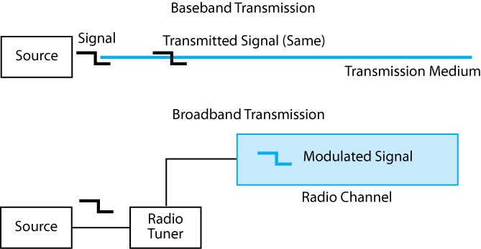
4-3: Baseband Versus Broadband Transmission
Notes:
The “BASE” in the names of Ethernet standards means baseband transmission.
In baseband transmission, the signal is merely injected into the transmission medium.
There is another type of transmission, called broadband transmission.
Broadband transmission uses radio.
The original signal is modulated by a radio tuner and sent in a channel.
Today, Ethernet does not use broadband transmission, so all standards have BASE in them.

Slide 13
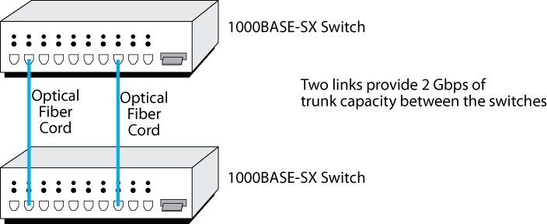
4-4: Link Aggregation (Trunking or Bonding)
Notes:
Suppose that you have a switch that has 1000BASE-SX ports.
Suppose also that you need to be able to connect the two switches at 1.7 Gbps.
All new switches can do link aggregation, which is also called trunking or bonding.
By connecting two 1000BASE-SX ports on the two switches, you can get 2 Gbps.
Aggregating two 1000BASE-SX links is much less expensive than buying a 10 Gbps port for each switch.
Usually, however, beyond about four links, it is cheaper to upgrade to 10Gbps ports.
This number is approximate and changes over time as prices change.
The key point is that a few links is cost-effective but beyond some point, bonding is not economical.

Slide 14


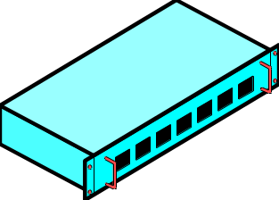
4-5: Data Link Using Multiple Switches
Original
Signal
Received
Signal
Regenerated
Signal
Switches regenerate signals before sending them out;
this removes propagation effects
It therefore allows signals to travel farther
Notes:
OK, new topic.
We know that when signals propagate, they suffer from propagation effects.
However, what happens when a signal passes through several switches? Is it continually degraded along the path?
The answer is, “No.” If a switch receives a signal correctly, it regenerates it to its original form before sending it on.
[This is like getting a good night’s sleep and starting again fresh.]

Slide 15
Figure 4-5: Data Link Using Multiple Switches
Received
Signal
Original
Signal
Received
Signal
Regenerated
Signal
Received
Signal
Regenerated
Signal
Thanks to regeneration, signals can travel far across
a series of switches
Notes:
<Read the text below the figure.>
<Trace the regeneration process through the figure.>

Slide 16
4-5: Data Link Using Multiple Switches
Received
Signal
Original
Signal
Received
Signal
Received
Signal
Regenerated
Signal
Regenerated
Signal
UTP
62.5/125
Multimode Fiber
UTP
100BASE-TX
(100 m maximum)
Physical Link
1000BASE-SX
(220 m maximum)
Physical Link
100BASE-TX
(100 m maximum)
Physical Link
Each trunk line along the way has a distance limit
Notes:
Each trunk line along the way has a distance limit.
<Go through the distance limits on each of the three links.>

Slide 17
4-5: Data Link Using Multiple Switches
Received
Signal
Original
Signal
Received
Signal
Regenerated
Signal
Received
Signal
Regenerated
Signal
UTP
62.5/125
Multimode Fiber
UTP
100BASE-TX
(100 m maximum)
Physical Link
1000BASE-SX
(220 m maximum)
Physical Link
100BASE-TX
(100 m maximum)
Physical Link
Station-to-station data link does not have a maximum distance
(420 m maximum distance in this example)
Notes:
Although the individual links have distance limitations, a host-to-host data link across multiple switches does NOT have a maximum distance.
In this case, 420 meters can be spanned.

Slide 18
Ethernet Data Link Layer Standards
The MAC Layer
Notes:
Now we have finished Ethernet standards at the physical layer.
We will begin to look at standards at the data link layer.

Slide 19
Figure 4-6: Layering in 802 Networks
Internet Layer
TCP/IP Internet
Layer Standards
(IP, ARP, etc.)
Other Internet
Layer Standards
(IPX, etc.)
The 802 LAN/MAN Standards Committee
subdivided the data link layer
The media access control (MAC) layer
handles details specific to a
particular technology (Ethernet 802.3,
802.11 for wireless LANs, etc.)
The logical link control layer
handles some general functions:
Connection to the internet layer, etc.;
Not important to corporate
networking professionals
Data
Link
Layer
Logical
Link
Control
Layer
802.2
Media
Access
Control
Layer
Ethernet 802.3 MAC Layer
Standard
Non-Ethernet
MAC Standards
(802.5,
802.11, etc.)
Physical Layer
100BASE-
TX
1000
Base-
SX
…
Non-Ethernet
Physical
Layer
Standards
(802.11, etc.)
Notes:
<Read the text in the box on the right.>

Slide 20
Figure 4-6: Layering in 802 Networks
Internet Layer
TCP/IP Internet
Layer Standards
(IP, ARP, etc.)
Other Internet
Layer Standards
(IPX, etc.)
Ethernet only has a single MAC standard
(The 802.3 MAC Layer Standard)
Ethernet has many physical layer standards (Fig. 4-2)
Data
Link
Layer
Logical
Link
Control
Layer
802.2
Media
Access
Control
Layer
Ethernet 802.3 MAC Layer
Standard
Non-Ethernet
MAC Standards
(802.5,
802.11, etc.)
Physical Layer
100BASE-
TX
1000
BASE-
SX
…
Non-Ethernet
Physical
Layer
Standards
(802.11, etc.)
Notes:
<Read the box near the top.>

Slide 21
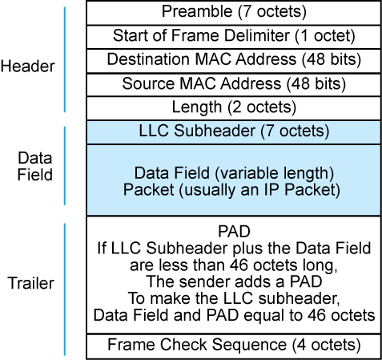
4-7: The Ethernet MAC-Layer Frame
Notes:
This is the layout of the Ethernet MAC layer frame.
Each field is a certain number of octets long.
The preamble frame arrives first.

Slide 22
4-7: The Ethernet MAC-Layer Frame
Header
  Preamble Field
    A series of 7 octets
    Each octet is 10101010
    Provides a synchronizing signal for the receiver’s clock
    Like a quarterback saying, “Hut one, hut two, hike!”
  Start of Frame Delimiter Field
    A single octet of 10101011
    Finishes the synchronization
Notes:
<Read the slide.>

Slide 23
4-7: The Ethernet MAC-Layer Frame
Header
  Destination and source MAC addresses
  Each is 48 bits long
  Computers and switches work with the 48-bit numbers
  For humans, converted into hexadecimal notation
    Base 16
  Look like: A1-1B-23-DF-FF-00
    Six pairs of symbols separated by dashes
    Each symbol represents four bits
    Symbols are 0 through 9 or A through F
Notes:
<Read the slide.>

Slide 24
Figure 4-8: Hexadecimal Notation
4 Bits* | Decimal (Base 10) | Hexadecimal (Base 16) |  | 4 Bits* | Decimal (Base 10) | Hexadecimal (Base 16)
0000 | 0 | 0 hex |  | 1000 | 8 | 8 hex
0001 | 1 | 1 hex |  | 1001 | 9 | 9 hex
0010 | 2 | 2 hex |  | 1010 | 10 | A hex
0011 | 3 | 3 hex |  | 1011 | 11 | B hex
0100 | 4 | 4 hex |  | 1100 | 12 | C hex
0101 | 5 | 5 hex |  | 1101 | 13 | D hex
0110 | 6 | 6 hex |  | 1110 | 14 | E hex
0111 | 7 | 7 hex |  | 1111 | 15 | F hex
*Note: With 4 bits, there can be 2⁴ = 16 possible “Hex” symbols…
Notes:
Hexadecimal notation works on groups of four bits.
Computer scientists call four bits a “nibble” because it is half a byte.
With four bits, there are 24 or 16 possible “Hex” symbols.
<Go through a few rows.>
<When you get to 10, note that you can’t use “10” because you need to have a single symbol, not 2.>
<Note that counting then begins with A and continues through F.>

Slide 25
Figure 4-8: Hexadecimal Notation
To convert a 48-bit MAC address to “hex”
  Divide it into octets
  Divide each octet into nibbles
    So 10000001 becomes 1000 0001
  Change each nibble to a hex symbol
  1000 = A and 0001 is 1
  Write the two hex symbols together as A1
  Separate the six octets of the MAC address with dashes
    A1-2B-39-FD-FF-FF
Notes:
<Read the slide>

Slide 26
4-7: Ethernet MAC Layer Frame
Header
  Length field gives the length of the data field in octets
Data Field
  LLC subheader (7 octets) that describes the contents of the rest of the data field
  Followed (usually) by an IP packet
PAD
  Added by sender if the data field is less than 46 octets
  If added, PAD is long enough to bring the data field plus the PAD to 46 octets
Notes:
<Read the slide>

Slide 27
4-7: Ethernet MAC Layer Frame
Trailer
  Frame Check Sequence
    4-octet field
    Sender calculates a number based on the contents of the other fields, places it into the frame check sequence field
    Receiver redoes the calculation on the values in the received frame
    If the receiver’s number is different from the sender’s, there has been a transmission error
      The receiver drops the frame
      There is no retransmission
Notes:
<Read the slide>

Slide 28
Multi-Switch Ethernet LAN Operation
Notes:
Let’s see how Ethernet moves frames from one switch to another along the data link through a single network.

Slide 29
4-9: Multiswitch Ethernet LAN
Switch 2
Port 5 on Switch 1
to Port 3 on Switch 2
Port 7 on Switch 2
to Port 4 on Switch 3
The Situation:
A1… Sends to E5…
Frame must go through
3 switches along the way
(1, 2, and then 3)
Switch 1
Switch 3
B2-CD-13-5B-E4-65
Switch 1, Port 7
A1-44-D5-1F-AA-4C
Switch 1, Port 2
D5-47-55-C4-B6-9F
Switch 3, Port 2
E5-BB-47-21-D3-56
Switch 3, Port 6
Notes:
Let’s see what happens when there are multiple switches are involved.
Computer A1-45-D5-1F-AA-4C, which connects to Switch 1 want to send a frame to E5-BB-47-21-D3-56, which attaches to Switch 3.
The frame will have to go to Switch 1, then to Switch 2, and then to Switch 3.

Slide 30
4-9: Multiswitch Ethernet LAN
On Switch 1
Switch 2
Switching Table Switch 1
Port Station
2 A1-45-D5-1F-AA-4C
7 B2-CD-13-5B-E4-65
5 D5-47-55-C4-B6-9F
5 E5-BB-47-21-D3-56
Port 5 on Switch 1
to Port 3 on Switch 2
Switch 1
B2-CD-13-5B-E4-65
Switch 1, Port 7
A1-44-D5-1F-AA-4C
Switch 1, Port 2
E5-BB-47-21-D3-56
Switch 3, Port 6
Notes:
Computer A1-45-D5-1F-AA-4C transmits a frame.
The frame goes into Switch 1, via Port 4.
Switch 1 reads the destination address, E5-BB-47-21-D3-56.
It looks this address up in its switching table.
The row is marked with a green arrow.
The row says that the switch should send the frame out Port 5.
The switch does so.
The frame goes out Port 5, along the trunk line to Switch 2.
It goes into Port 3 on Switch 2.

Slide 31
4-9: Multiswitch Ethernet LAN
On Switch 2
Switch 2
Port 5 on Switch 1
to Port 3 on Switch 2
Port 7 on Switch 2
to Port 4 on Switch 3
Switch 1
Switch 3
Switching Table Switch 2
Port Station
A1-44-D5-1F-AA-4C
3 B2-CD-13-5B-E4-65
D5-47-55-C4-B6-9F
7 E5-BB-47-21-D3-56
E5-BB-47-21-D3-56
Switch 3, Port 6
Notes:
Now we will look at what happens on Switch 2.
Switch 2 also looks up the destination address in the field (E5-BB-47-21-D3-56).
It looks this address up in its switching table.
Based on the indicated row, the switch sends the frame out Port 7.
The frame travels down the trunk line between Switch 2 and Switch 3.
It enters Switch 3 through Port 4.

Slide 32
4-9: Multiswitch Ethernet LAN
Switch 2
Switching Table Switch 3
Port Station
4 A1-44-D5-1F-AA-4C
B2-CD-13-5B-E4-65
2 D5-47-55-C4-B6-9F
6 E5-BB-47-21-D3-56
Port 7 on Switch 2
to Port 4 on Switch 3
On Switch 3
Switch 3
A1-44-D5-1F-AA-4C
Switch 1, Port 2
D5-47-55-C4-B6-9F
Switch 3, Port 2
E5-BB-47-21-D3-56
Switch 3, Port 6
Notes:
Switch 3 also looks up E5-BB-47-21-D3-56 in its switching table.
It notes that it should send the frame out Port 6.
It does so.
The frame travels over the access line out Port 6 to computer E5-BB-47-21-D3-56.
The frame’s journey through the multi-switch network is finished.

Slide 33
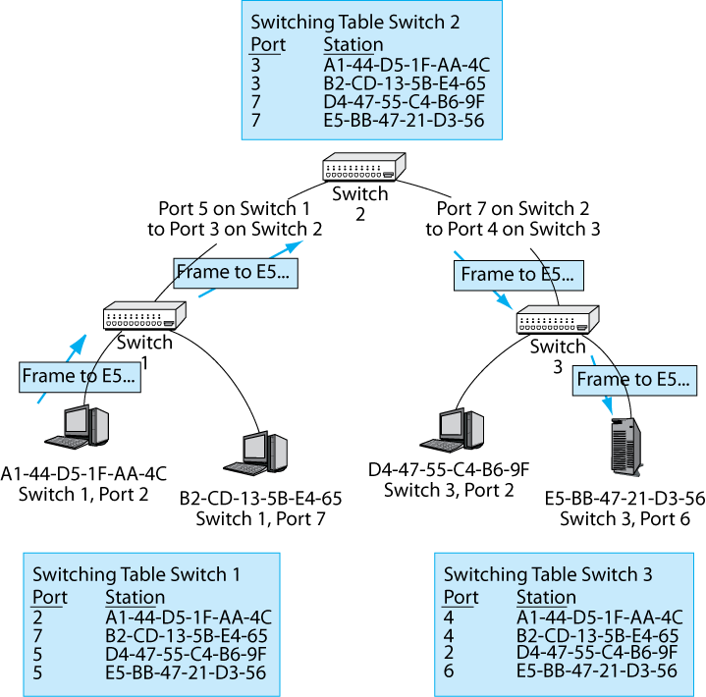
Figure 4-9: Multiswitch Ethernet LAN
Notes:
<Go quickly through this recap.>

Slide 34
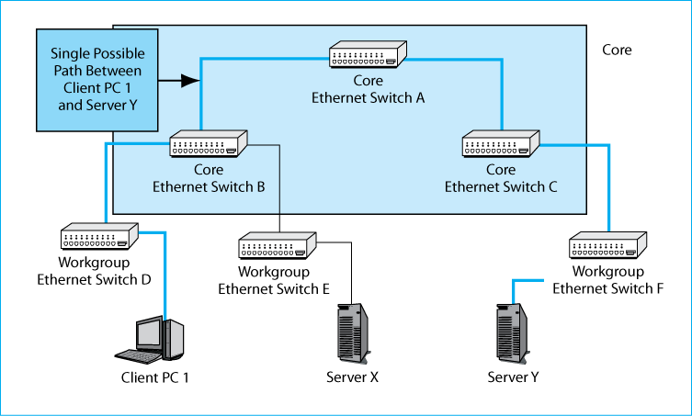
4-10: Hierarchical Ethernet LAN
Notes:
In Ethernet, hosts connect to workgroup switches.
Core switches connect switches together.
The group of all core switches is called the network’s core.
Ethernet switches MUST be organized in a hierarchy.
If you create a loop, bad things happen.
<Trace the single path between Client PC1 and Server X.>
<Trace the single possible path between Client PC1 and Server Y.>

Slide 35
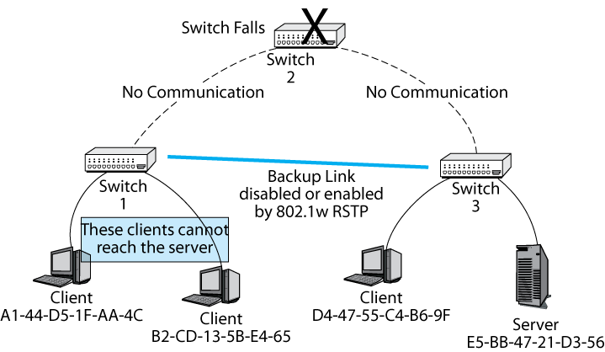
4-11: Single Point of Failure and 802.1D
Notes:
The problem with requiring a hierarchy is that it is vulnerable to single points of failure.
Ignore the backup link for a moment.
If Switch 2 fails, then the network will be cut in two.
The Clients on the left (A1 and B2) cannot reach the server to do their work.
To provide more reliability, Ethernet allows you to install a backup link, in this case, between Switch 1 and Switch 3.
Of course, this backup link creates a loop between the three switches.
When the switches detect the loop, they use the 802.1w rapid spanning tree protocol (RSTP) to deactivate the backup link.
This restores the hierarchy.
However, if Switch 2 fails, the switches use RSTP to reactivate the backup link.
This restores connectivity between the two clients on the left and the server.

Slide 36
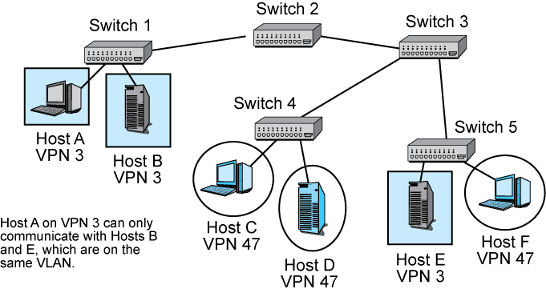
4-12: Virtual LAN (VLAN) with Ethernet Switches
Notes:
In Ethernet, a company can divide its clients and servers logically into virtual LANs (VLANs).
Clients and servers can only send frames to each other if they are on the same VLAN.
So Host A on VPN3 can only communicate with hosts B and E, which are on the same VLAN.
It cannot communicate with Host C, Host D, or Host F.
VLANs can reduce congestion when hosts broadcast to all other hosts, as they sometimes do.
The broadcast only goes to stations on the same VLAN.
VLANs also provide security. A client on one VLAN cannot communicate with a server on another VLAN.

Slide 37
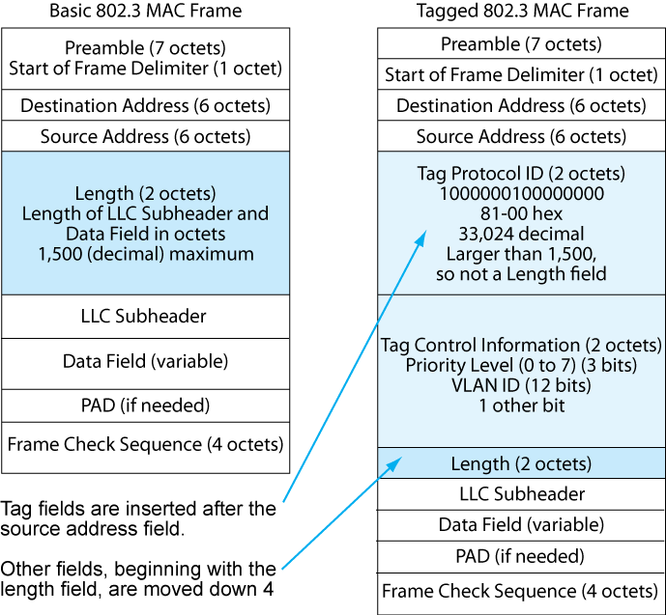
4-13: Tagged Ethernet Frame (Governed by 802.1Q)
Notes:
The basic 802.3 MAC layer frame does not have a field to hold a VLAN number to mark a frame as belonging to a particular VLAN.
To permit this, and also to permit priority levels among frames, the 802.1Q standard adds two fields after the two address fields.
The first field, the Tag Protocol ID field mere indicates by its value (33,024 decimal) that the frame is tagged.
The second field, the Tag Control Information Field, contains the VLAN ID number.
The Tag Control Information Field also has a 3-bit priority number which can designate one of 8 levels of priority (0 through 7).
Other fields, beginning with the length field, are pushed down by four octets.

Slide 38
Handling Momentary Traffic Peaks
Overprovisioning and Priority
Notes:
<Continue to the next slide.>

Slide 39
4-14: Handling Momentary Traffic Peaks with Overprovisioning and Priority
Momentary Traffic Peak:
Congestion and Latency
Traffic
Momentary Traffic Peak:
Congestion and Latency
Network Capacity
Momentary traffic peaks usually last only
a fraction of a second;
They occasionally exceed the network’s capacity.
When they do, frames will be delayed, even dropped.
Time
Notes:
Now we look at a new problem, momentary traffic peaks.
<Read the box in the lower left.>
<Emphasize that momentary traffic peaks usually are very brief—a few milliseconds to a few seconds at the most.>
Delay is bad for many applications such as voice over IP.
Frame loss is bad for all applications.
Often, lost frames will be retransmitted.
However, this will only add to the traffic overload if the retransmission takes place during the traffic peak.

Slide 40
4-14: Handling Momentary Traffic Peaks with Overprovisioning and Priority
Overprovisioned Traffic Capacity in Ethernet
Traffic
Overprovisioned Network Capacity
Momentary Peak:
No Congestion
Overprovisioning:
Build high capacity than will rarely if ever be exceeded.
This wastes capacity.
But cheaper than using priority (next)
Time
Notes:
The simplest way to manage momentary traffic peaks in Ethernet is to overprovision the network—that is, give it far more capacity than it needs nearly all of the time.
For instance, if a 100BASE-TX line is good most of the time, replace it with a 1000BASE-TX line.
With sufficient overprovisioning, momentary traffic peaks will rarely exceed the capacity.
This is wasteful of capacity, but it typically is cheaper than the approach we will see next, which is to use frame priority.

Slide 41
4-14: Handling Momentary Traffic Peaks with Overprovisioning and Priority
Priority in Ethernet
Traffic
Momentary
Peak
High-Priority Traffic Goes
Low-Priority Waits
Network Capacity
Priority:
During momentary peaks, give priority to
traffic that is intolerant of latency (delay), such as voice.
No need to overprovision, but expensive to implement.
Ongoing management is very expensive.
Time
Notes:
A more elegant approach is to give frames priority levels.
During a momentary traffic peak, frames with high priority would still be sent through.
Network supervisory messages should have the highest priority.
Latency-intolerant applications such as voice over IP should also have high priority.
Lower-priority traffic, such as e-mail, will be delayed for a few moments.
However, this is unlikely to cause serious problems.
(Remember that these are very brief traffic peaks).
Switches today almost all support priority handling without extra cost.
However, the management cost of deciding which applications should get high priority is high.
Also, the networking staff may have to handle political pressure from departments, all of which may feel that their applications should have the highest priority.

Slide 42
Hub Versus Switch Operation
Box
Notes:
In job interviews, students are often asked about CSMA/CD.
This is a shame, because CSMA/CD is not used with switches.
It is only used with an older connecting technology called the hub.
Hubs are no longer in use and have not been sold for several years.
Consequently, this information is presented in a box.

Slide 43
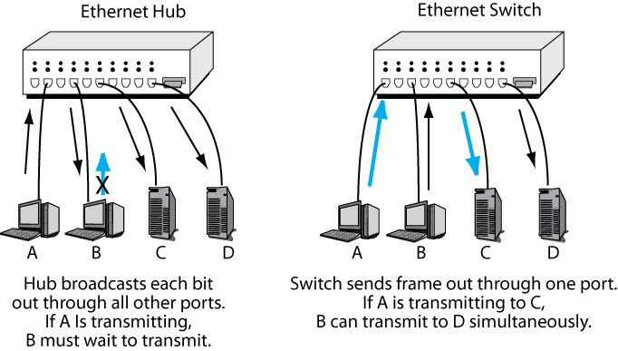
4-15: Hub Versus Switch Operation
Box
Today, Switches Dominate in Ethernet
  A frame comes in one port
  The switch looks up the frame’s destination MAC address in the switching
  table
  The switch sends the frame
  out a single port
  Only two ports are tied up
  Other conversations can
  take place on other port
  pairs simultaneously
Figure 4-16
Notes:
<Read the slide.>

Slide 44
4-15: Hub versus Switch Operation
Box
Today, Switches Dominate in Ethernet
  Earlier Ethernet networks used hubs
  When a bit came in one port, the hub broadcast the bit out through all other ports
  If A is transmitting, B and all
  other stations have to wait until
  A finishes transmitting
  Otherwise, their signals
  will collide, and both will
  be unreadable
  Media access control (MAC)
  prevents this
Figure 4-16
Notes:
<Read the slide.>

Slide 45
4-15: Hub versus Switch Operation
Box
CSMA/CD
  The Ethernet hub MAC protocol
  CSMA (carrier sense multiple access)
    If a station wants to transmit
    If no station is already transmitting, it may send immediately
    If another station is already sending, it must wait a random amount of time
      After that random amount of time, the station begins CSMA again
      Does NOT simply send after a wait if another station is transmitting
Notes:
<Read the slide.>

Slide 46
4-15: Hub versus Switch Operation
Box
CSMA/CD
  CD (collision detection)
    If there is a collision because two stations send at the same time, all stations stop transmitting, wait a random period of time, and
    It must then apply CSMA again (it may not transmit simply because the random period of time is over)
Notes:
<Read the slide.>

Slide 47
4-15: Hub versus Switch Operation
Box
Latency
  When one station transmits, others must wait
  This creates latency
  Latency became bad in large Ethernet hub networks
  Switches solved this problem by avoiding the need to wait
  Multiple conversations can take place simultaneously
Notes:
<Read the slide.>

Slide 48
Switch Purchasing Considerations
Notes:
When you purchase and Ethernet switch, you have to consider several factors that are important in terms of performance and price.

Slide 49
4-17: Switch Purchasing Considerations
Number and Speeds of Ports
  Buyers must decide on the number of ports needed and the speed of each
  Buyers often can buy a prebuilt switch with this configuration
Notes:
<Read the slide.>

Slide 50
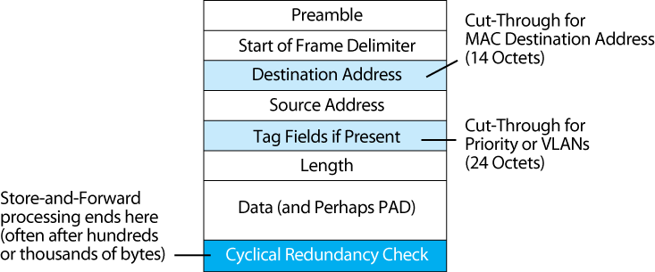
4-18: Store-and-Forward Versus Cut-Through Switching
Store-and-forward switches receive the entire frame before sending bits back out
Cut-through switches send the frame out after only a few octets
Cut-through switches reduce latency, but this is rarely important at today’s switch speeds
Notes:
<Read the text at the bottom.>
[Note. This distinction is not important in the market, but students often get asked about it in job interviews].

Slide 51
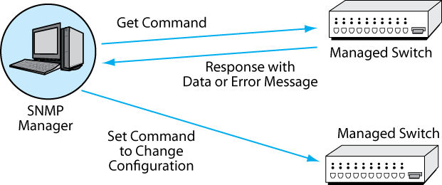
4-17: Switch Purchasing Considerations
Manageability
  SNMP Manager controls many managed switches (see Figure 4-19)
Figure 4-19
Notes:
Some switches are called manageable switches.
These can be managed from a central manager.
Management uses the SNMP protocol we saw in Chapter 1.

Slide 52
4-17: Switch Purchasing Considerations
Manageability
  Polling enables managers to collect data and diagnose problems
  Switches can be fixed remotely by changing their configurations
Notes:
<Read the two bullet points.>

Slide 53
4-17: Switch Purchasing Considerations
Manageability
  Manager provides the network administrator with summary performance data
  Managed switches are substantially more expensive than unmanaged switches
  However, in large networks, the savings in labor costs and rapid response are worth it, reducing the TCO compared with unmanaged switches
Notes:
<Read the slide.>
[TCO is the total cost of ownership.]

Slide 54
Physical and Electrical Features
Box
Other Purchasing Considerations
Notes:
We come to another box, which indicates nonessential information.
However, while this material does not represent any theoretical concepts, it is useful to understand switch purchasing options.

Slide 55
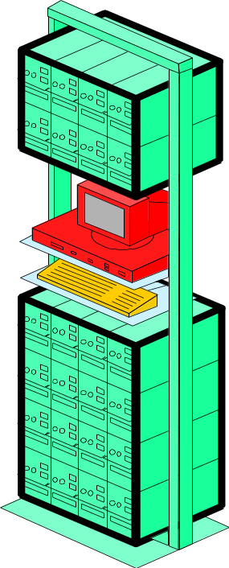
4-20: Physical and Electrical Features
Box
Physical Size
  Switches fit into standard 19-in wide (48-cm wide) equipment racks
  Switch heights usually are multiples of 1U (1.75 in or 4.4 cm)
19 inches
(48 cm)
Notes:
<Read the slide.>

Slide 56
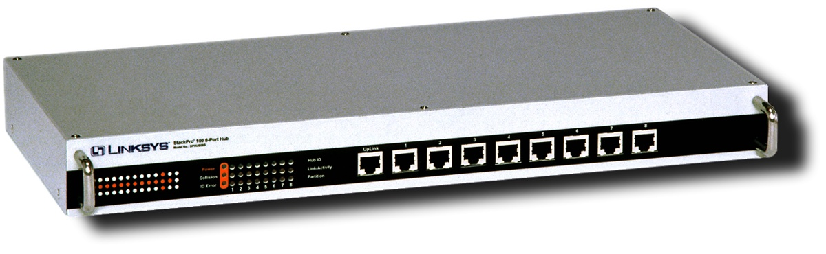
4-20: Physical and Electrical Features
Box
Box
Port Flexibility
  Fixed-port switches
    No flexibility: The number of ports is fixed
    1 or 2U tall
    Most workgroup switches are fixed-port switches
Notes:
<Read the slide.>

Slide 57
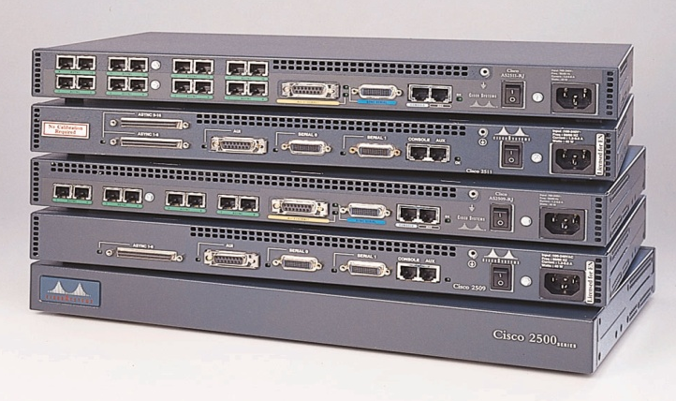
4-20: Physical and Electrical Features
Box
Port Flexibility
  Stackable switches
    Fixed number of ports
    1U or 2U tall
    High-speed interconnect bus connects stacked switches
    Ports can be added in increments of as few as 12
Notes:
<Read the slide.>

Slide 58
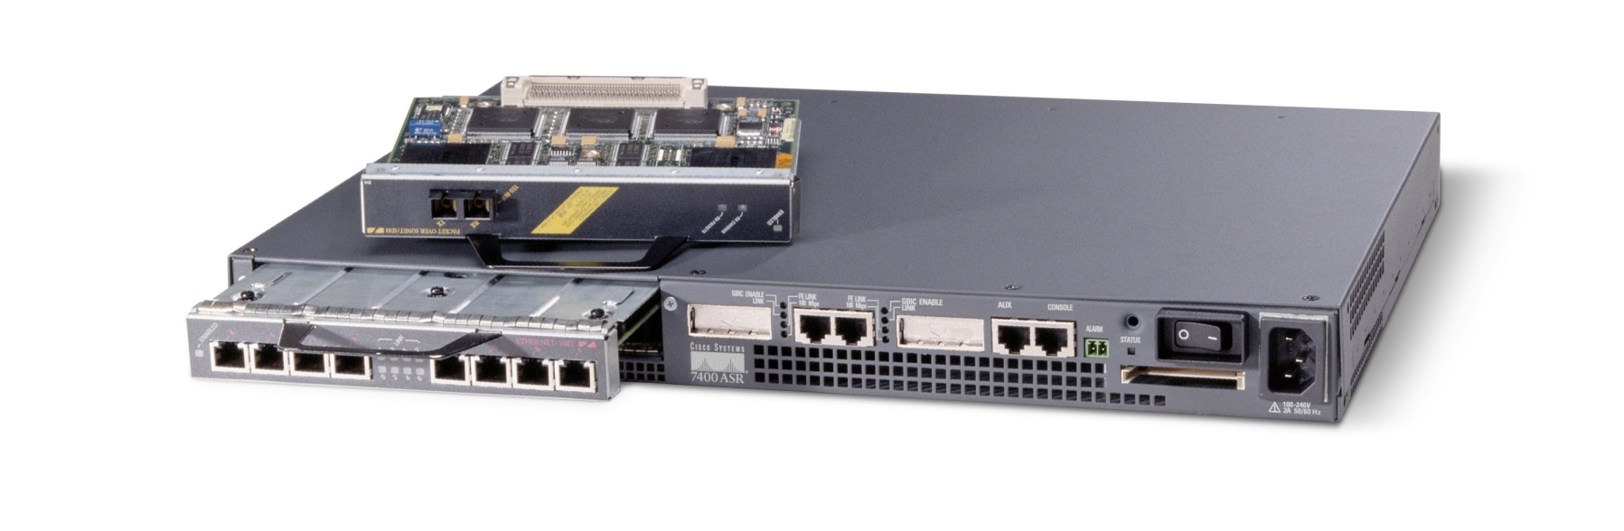
4-20: Physical and Electrical Features
Box
Port Flexibility
  Modular switches
    1U or 2U tall
    Contain one or a few slots
    Each slot module contains 1 to 4 ports
Module
Notes:
<Read the slide.>

Slide 59
4-20: Physical and Electrical Features
Box
Port Flexibility
  Modular Switches
    1 or 2U tall
    Contain one or a few slots for modules
    Each module usually contains 1 to 4 ports
Module
Notes:
<Read the slide.>

Slide 60
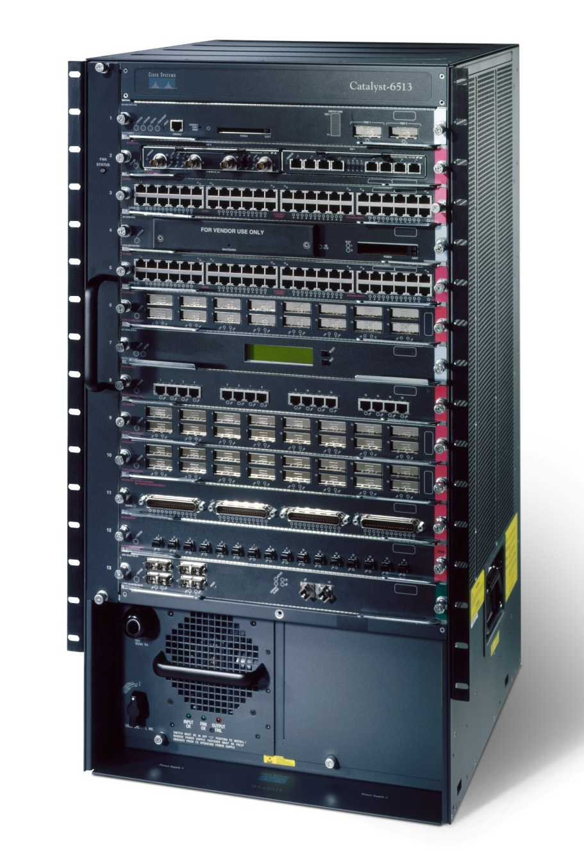
4-20: Physical and Electrical Features
Box
Port Flexibility
  Chassis switches
    Several U tall
    Contain several expansion slots
    Each expansion board contains several slots
    Most core switches are chassis switches
Notes:
<Read the slide.>

Slide 61
4-20: Physical and Electrical Features
Box
Uplink Ports
  Normal Ethernet RJ-45 switch ports transmit on Pins 3 and 6 and listen on Pins 1 and 2
    If you connect two normal switch ports on different switches via UTP cords, the ports will not be able to communicate
    A crossover cable solves this problem
Pins
1 & 2
Pins
1 & 2
Normal
Switch Port
On Parent
Switch
Normal
Switch
Port
Pins
3 & 6
Crossover
Cable
Pins
3 & 6
Notes:
<Read the slide.>

Slide 62
4-20: Physical and Electrical Features
Box
Uplink Ports
  Most switches have at least one uplink port, which transmits on Pins 1 and 2. You can use an ordinary UTP cord to connect a UTP uplink port on one switch to any normal port on a parent switch
  Today, most switches have ports that automatically turn into uplink ports when they detect a switch at the end of the link
Notes:
<Read the slide.>

Slide 63
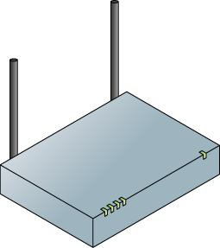
4-20: Physical and Electrical Features
Box
Electrical Power
  Switches require electrical power
  In addition, switches can provide electrical power to devices connected by UTP
  With Power over Ethernet (POE), switches can supply power to devices connected by UTP
UTP
Data and Power
Notes:
<Read the slide.>

Slide 64
4-20: Physical and Electrical Features
Box
Electrical Power
  Why is POE important?
    Installing devices like access points require an electrical plug to be nearby
    This often is not the case, and bringing power can be expensive
  Under the original 802.3af POE standard
    Provide up to 13 watts to attached devices
    Sufficient for simple wireless access points
    Sufficient for VoIP phones
Notes:
<Read the slide.>

Slide 65
4-20: Physical and Electrical Features
Box
Electrical Power
  Now, the 802.3at POE plus is under development
    30 or 60 watts
    Backwardly compatible with 802.3af
    Sufficient for multiband wireless access points (see Chapter 5)
    Sufficient for other small devices
    Still not sufficient for PCs
Notes:
<Read the slide.>

Slide 66
4-20: Physical and Electrical Features
Box
Electrical Power
  New switches can be purchased with POE and POE plus
    Can also add equipment to an existing switch
  Providing power can raise heat in wiring/switching rooms and switch rooms
Notes:
<Read the slide.>

Slide 67
Ethernet Security
Notes:
Until recently, security was not a concern with Ethernet LANs.
Today, many companies are adding security to Ethernet.

Slide 68
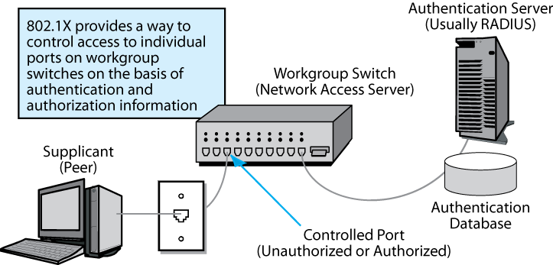
4-21: 802.1X Ethernet Port-Based Access Control
Danger: An attacker will walk in and plug into a wall jack
This bypasses the border firewall
Solution: Authenticate everyone who connects to an access switch
802.1X standardizes this authentication
Notes:
<Read the text at the bottom of the slide.>

Slide 69
4-21: 802.1X Ethernet Port-Based Access Control
Credentials
Credentials
Client PC is called the supplicant
It sends credentials (proof of identity) to the switch
The switch is called the network access server
The NAS sends the credentials onto a central authentication server
Notes:
<Read the text at the bottom of the slide.>

Slide 70
4-21: 802.1X Ethernet Port-Based Access Control
Credentials
Authentication server usually is a RADIUS server
Authentication server checks credentials
against its authentication database
Notes:
<Read the text at the bottom of the slide.>

Slide 71
4-21: 802.1X Ethernet Port-Based Access Control
Credentials
Centralizing credential checking brings consistency
No matter what switch the computer plugs into,
It will be authenticated with the same credentials database
Also, this database can be updated instantly if needed
Notes:
<Read the text at the bottom of the slide.>

Slide 72
4-21: 802.1X Ethernet Port-Based Access Control
Accept/
Reject
Accept/
Reject
RADIUS server sends accept or reject message to NAS
Switch accepts or rejects the supplicant client
Notes:
<Read the text at the bottom of the slide.>

Slide 73
4-22: Media Access Control (MAC) Security (802.1AE)
802.1X prevents unauthorized hosts from connecting to a switch
However, once hosts are admitted to the network, they can send false supervisory frames to switches
  This allows them to reroute frames to the wrong destination, stop forwarding frames, etc.
  The 802.1AE standard requires the sender of a supervisory frame to authenticate itself to the switch it sends the message to
Notes:
<Read the slide.>

Slide 74
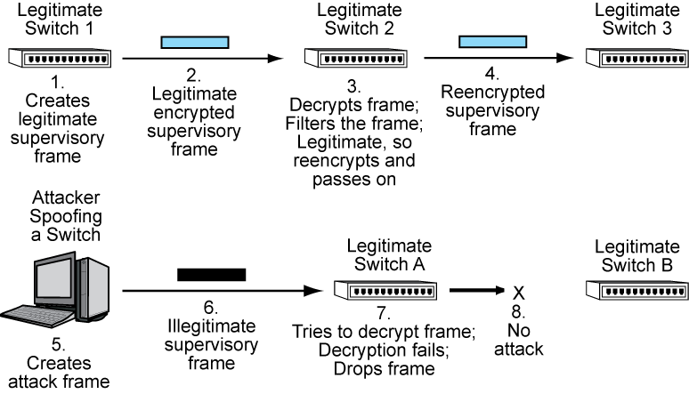
4-22: MAC Security (802.1AE)
The message is encrypted with a key that only the sending and receiving switches know
This authenticates the sender to the receiver because only the authentic sender would know the shared key
Encryption and decryption are done by each pair of switches along the way
Notes:
<Read the slide.>

Slide 75
4-22: MAC Security (802.1AE)
Here, the attacker spoofs a switch and creates an attack frame
It sends he illegitimate supervisory frame to Switch A
Switch A cannot decrypt the frame because the attacker did not know the correct key for encrypting it
Switch A drops the frame
The attack cannot go on to Switch B
Notes:
<Read the slide.>

Slide 76
Routed LANs
Notes:
Ethernet in this chapter and wireless LANs in the next chapter are the only two LAN technologies we will look at.
However, students should realize that many LANs are routed LANs, especially large LANs.

Slide 77
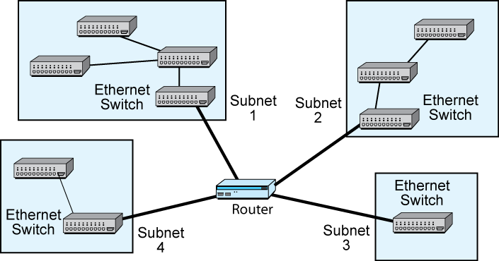
4-23: Routed LAN with Ethernet Subnets
If a routed LAN links multiple
Ethernet switched networks,
the switched networks are
called subnets
Notes:
<Read the text box.>
[Even the largest LANs can be completely switched.
However, if routers are used, this gives the network manager better control over transmission because routers are very sophisticated.]

Slide 78
Topics Covered

Slide 79
Topics Covered
Ethernet MAC Layer Standards
  Switch operation
    Operation of a hierarchy of switches
      Single possible path between any two computers
      Hierarchy gives low price per frame transmitted
      Single points of failure and the Spanning Tree Protocol
    VLANs and frame tagging to reduce broadcasting
    Momentary traffic peaks: addressed by overprovisioning and priority
    Hubs and CSMA/CD (in a box)

Slide 80
Topics Covered
Switch Purchasing Considerations
  Number and speed of ports
  Switching matrix (nonblocking)
  Store-and-forward versus cut-through switches
  Managed switches

Slide 81
Topics Covered
Box
Advanced Switch Purchasing Considerations
  Physical size
  Fixed-Port-Speeches
  Stackable Switches
  Modular Switches
  Chassis Switches
  Pins in Switch Ports and Uplink Ports
  Electrical Power (802.3af and 802.3at)

Slide 82
Topics Covered
Ethernet security
  802.1X Port-Based Access Control
  802.1AE MACsec
Routed LANs are possible

Slide 83

All rights reserved. No part of this publication may be reproduced, stored in a retrieval system, or transmitted, in any form or by any means, electronic, mechanical, photocopying, recording, or otherwise, without the prior written permission of the publisher. Printed in the United States of America.
Copyright © 2009 Pearson Education, Inc.
Publishing as Prentice Hall

